Slide 1
Expression Optimization

Slide 2
Expression Optimization
In some problems, the number of variables is unknown
Finding optimal solutions of problems with unknown parameters requires optimizing over the set of expressions

Slide 3
Grammars
Expressions can be represented by a tree of symbols
Grammars constrain the space of possible expressions
A grammar is represented by a set of production rules
Production rules involve symbols and types
Types are defined sets of expression trees
Production rules are used to form expression trees by expanding types into new expressions with more types and symbols
If a type is expanded into just symbols, preventing further expansion, then it is called a terminal

Slide 4
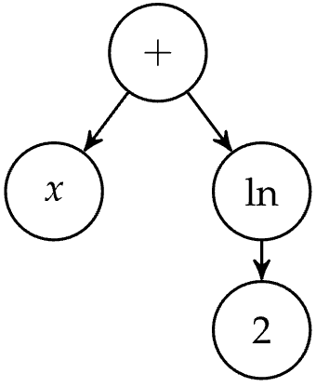
Grammars
Representing the expression x + ln 2 as a tree

Slide 5
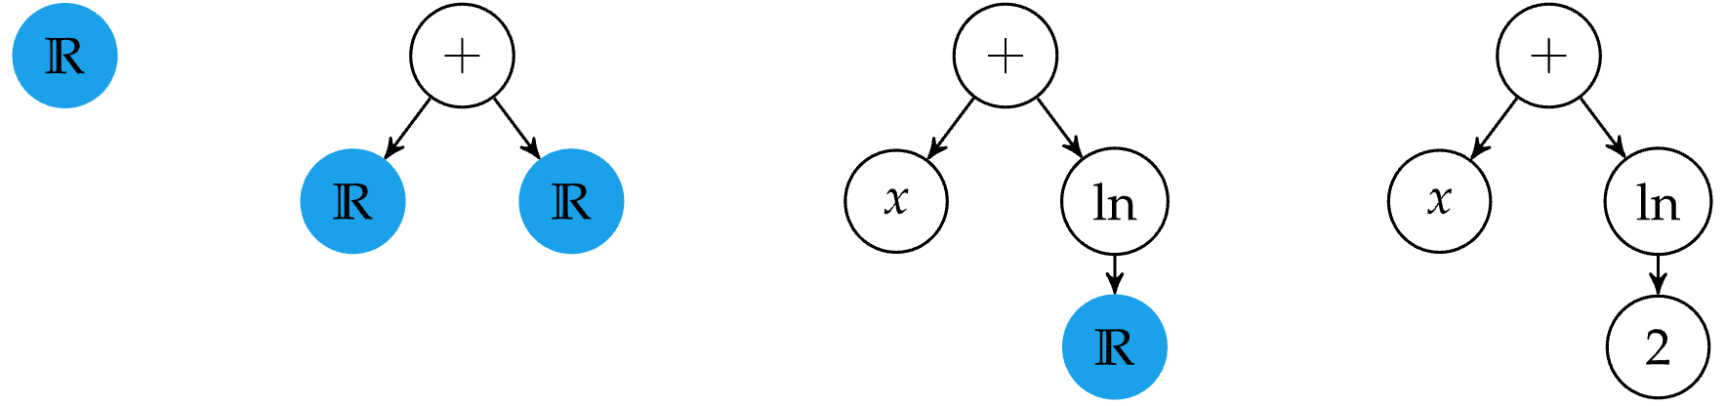

Grammars
Constructing the expression tree using a grammar
$ℝ$ ↦ $ℝ$ + $ℝ$
$ℝ \text{↦}$ x
$ℝ$ $\text{↦}$ ln($ℝ$)
$ℝ$ $\text{↦}$ 2

Slide 6
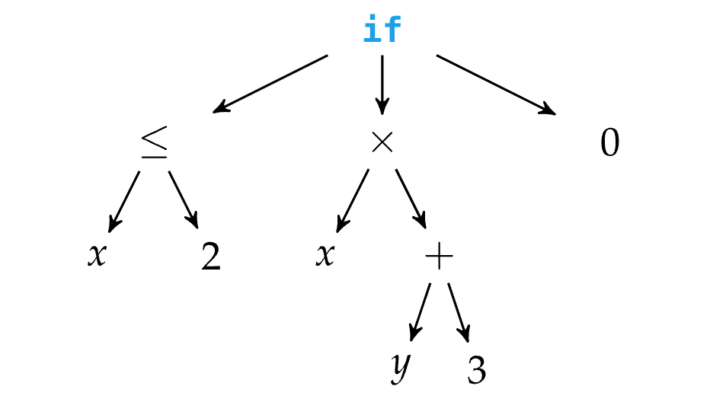
Genetic Programming
Genetic programming represents individuals as trees and optimizes over them using mutation and tree crossover

Slide 7
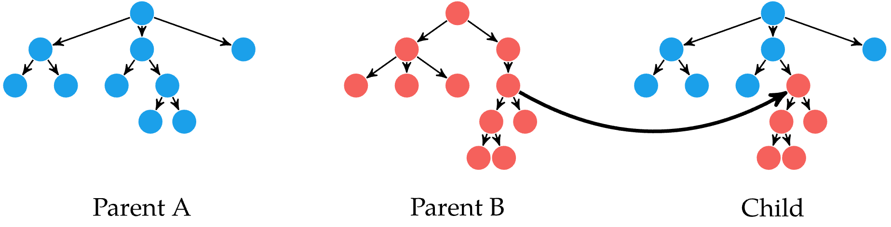
Genetic Programming
Tree crossover combines two parent trees into a child tree
Over many generations, tree crossover tends to increase tree depth and overall complexity
It is common to introduce a bias for parsimony, or simplicity in the solution based on the tree’s depth

Slide 8
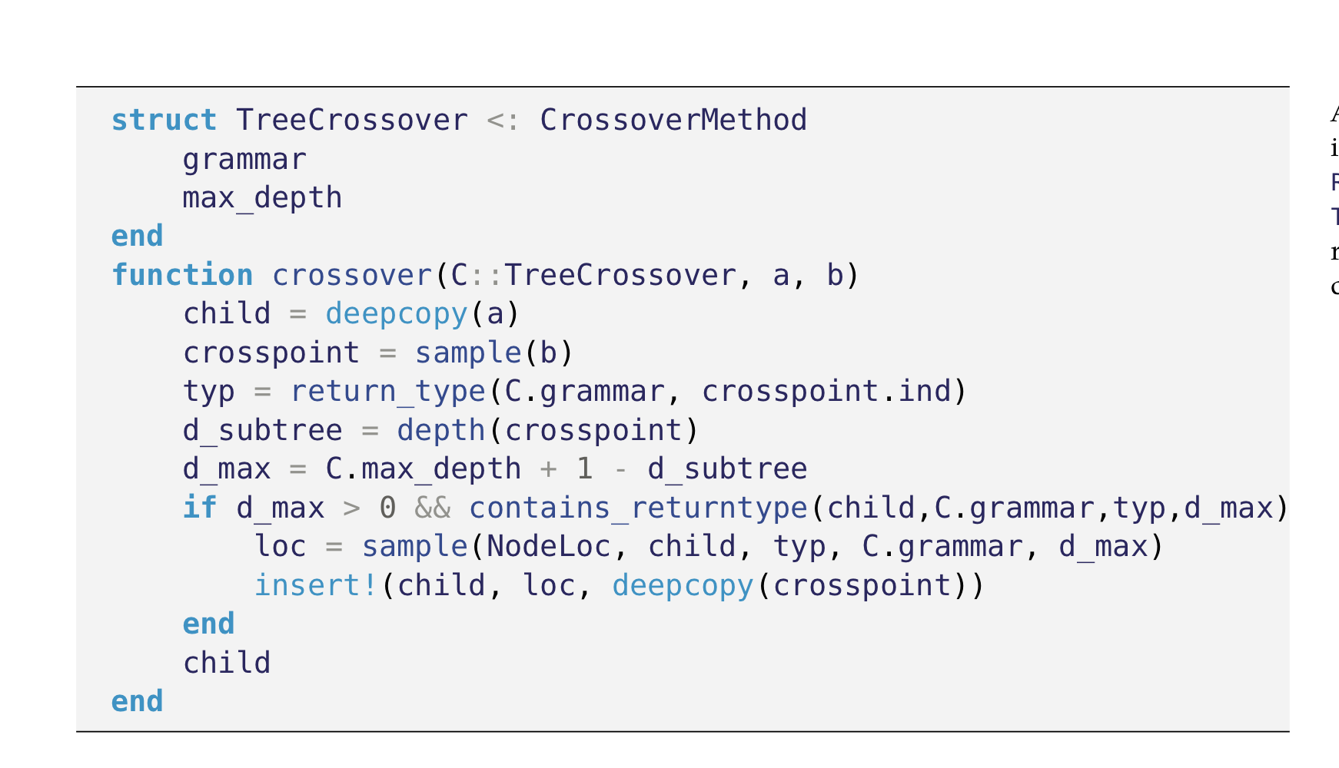

Slide 9
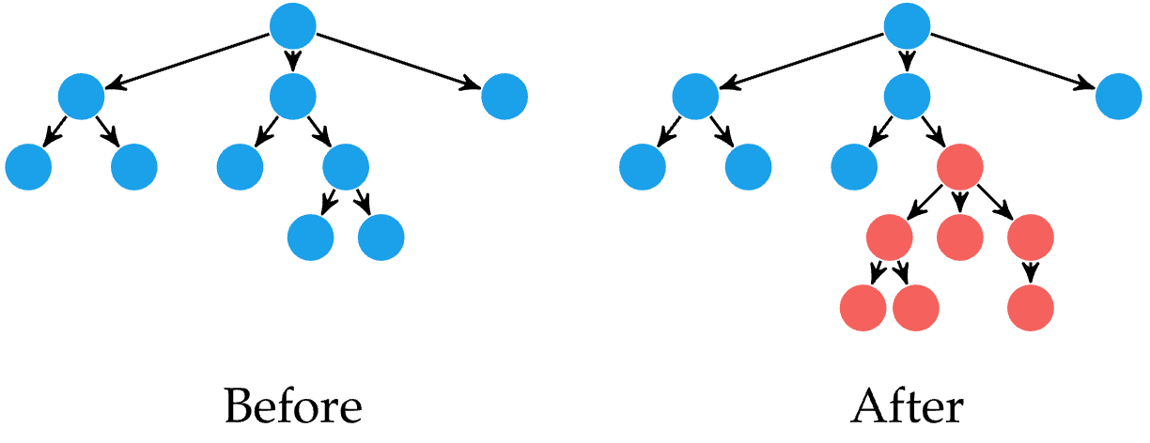
Genetic Programming
Random variation can be added in multiple ways
Tree mutation is when a random tree is generated and its root replaces a random node in the tree

Slide 10
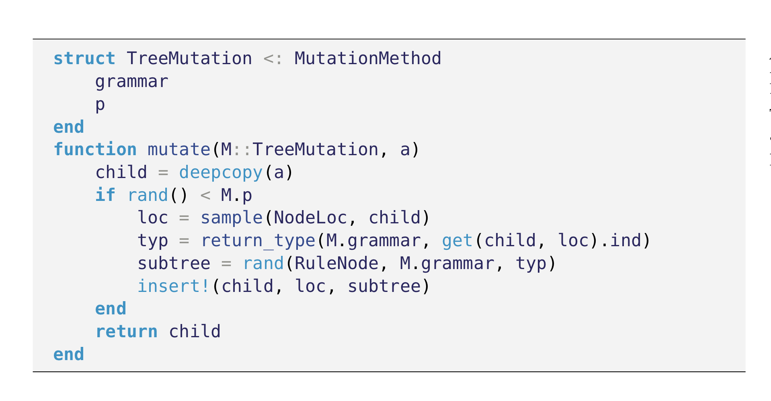

Slide 11
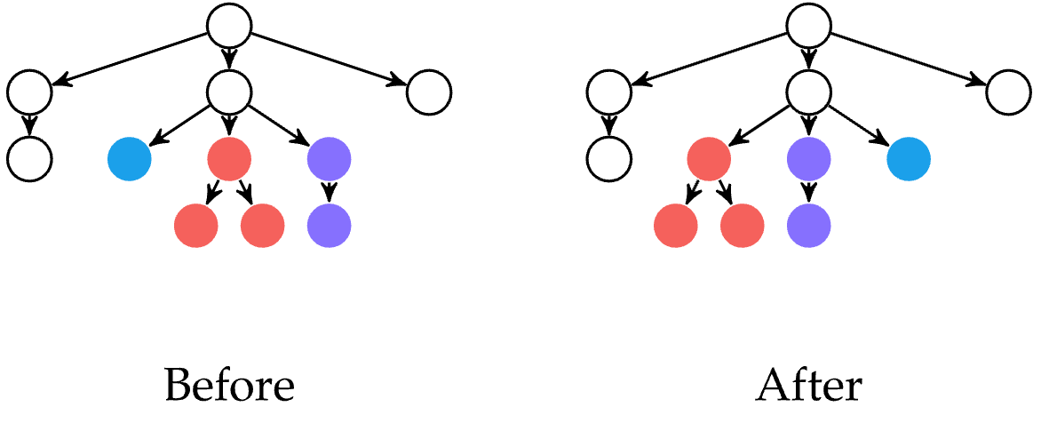
Genetic Programming
Tree permutation is when randomly chosen nodes are permuted
Often combined with tree mutation

Slide 12
